Slide 1
Threads & Concurrency Lecture 1 Introduction
David Liu
Fall 2021, Spring 2022

Slide 2
Learning Outcomes
Identify the basic components of a thread, and contrast threads and processes
Describe the benefits and challenges of designing multithreaded applications

Slide 3
Why Threads?
User Perspectives
Short response time
Complete quickly
e.g. web, word processor
System Perspectives
Utilize multicores or multiple CPUs

Slide 4
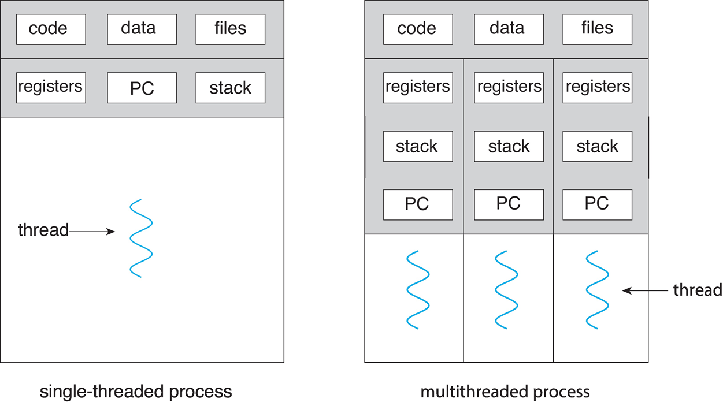
Single vs Multithreaded Processes

Slide 5
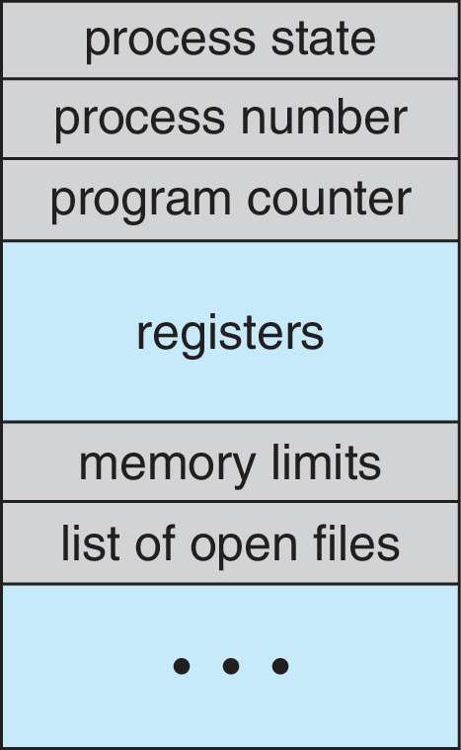
Process Control Block (PCB): Review
Process state
Program counter – location of instruction to next execute
CPU registers – contents of all process-centric registers
CPU scheduling information- priorities, scheduling queue pointers
Memory-management information – memory allocated to the process
Accounting information – CPU used, clock time elapsed since start, time limits
I/O status information – I/O devices allocated to process, list of open files

Slide 6
A Process, Multiple Threads
A thread
Program counter
Thread specific storage
How will this change PCB structure?

Slide 7
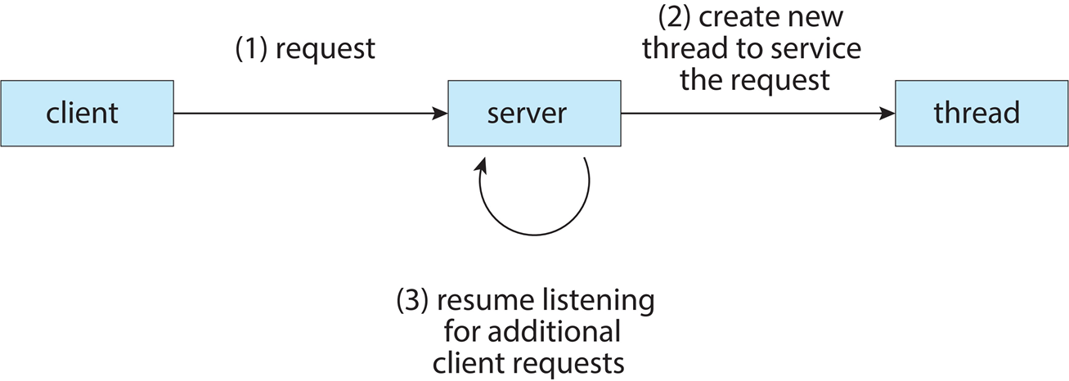
Multithreaded Server Architecture

Slide 8
Benefits
Responsiveness – may allow continued execution if part of process is blocked, especially important for user interfaces
Resource Sharing – threads share resources of process, easier than shared memory or message passing
Economy – cheaper than process creation, thread switching lower overhead than context switching
Scalability – process can take advantage of multicore architectures

Slide 9
Challenges
Dividing activities
Balance
Data splitting
Data dependency
Testing and debugging

Slide 10
Parallelism vs Concurrency
Parallelism implies a system can perform more than one task simultaneously
Concurrency supports more than one task making progress
Single processor / core, scheduler providing concurrency
Question: In a single processor (one core), is parallel operation, or two or more tasks running simultaneously possible?

Slide 11
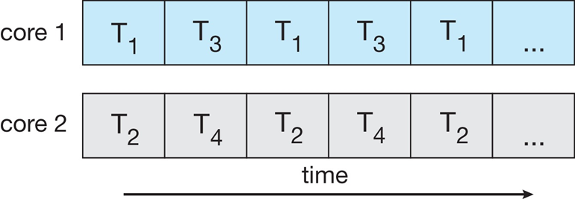
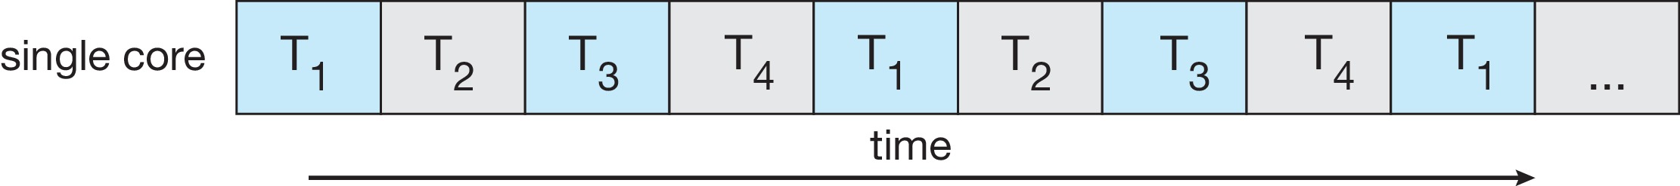
Parallelism vs Concurrency
Parallelism on a multi-core system:
Concurrent execution on single-core system:

Slide 12
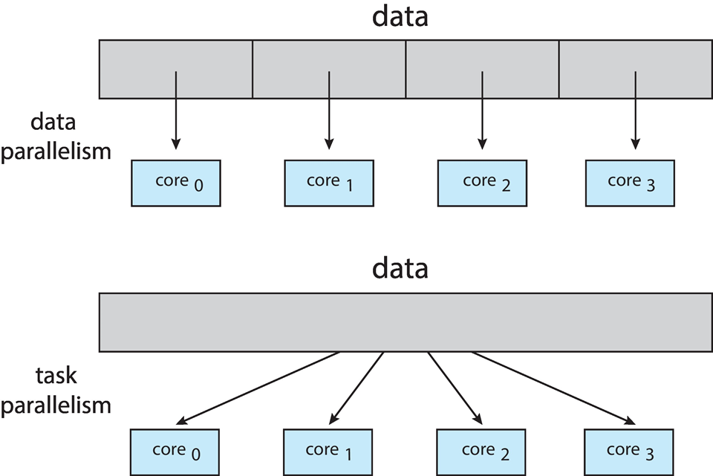
Data vs Task Parallelism
Data parallelism – distributes subsets of the same data across multiple cores, same operation on each
Task parallelism – distributing threads across cores, each thread performing unique operation

Slide 13
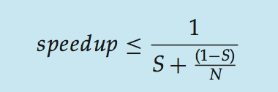
Amdahl’s Law
Serial portion of an application has disproportionate effect on performance gained by adding additional cores
S is serial portion, N processing cores
1/S

Slide 14
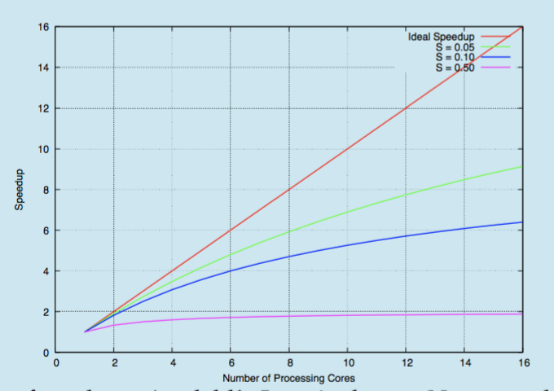
Amdahl’s Law

Slide 15
Thread Types
User threads
Managed by user-level threads library
Kernel threads
Supported by the kernel

Slide 16
User Threads
POSIX Pthreads
Windows threads
Java threads

Slide 17
Kernel Threads
Windows
Linux
Mac OS X
iOS
Android

Slide 18
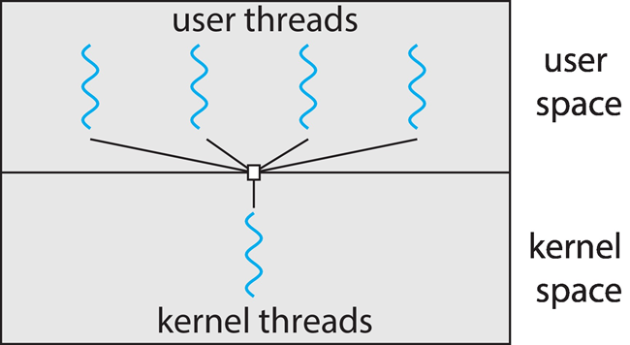
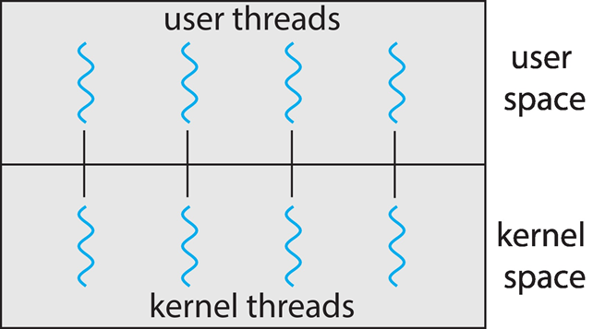
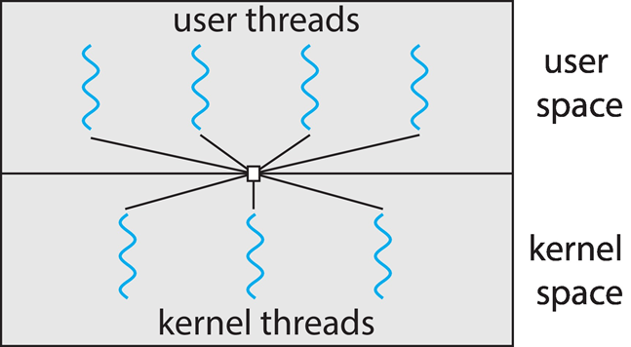
Map User Threads to Kernel Threads
Many-to-one One-to-One Many-to-Many

Slide 19

Many-to-One
Many user-level threads mapped to single kernel thread
One thread blocking causes all to block
Multiple threads may not run in parallel on muticore system because only one may be in kernel at a time
Few systems currently use this model
Examples:
Solaris Green Threads
GNU Portable Threads

Slide 20
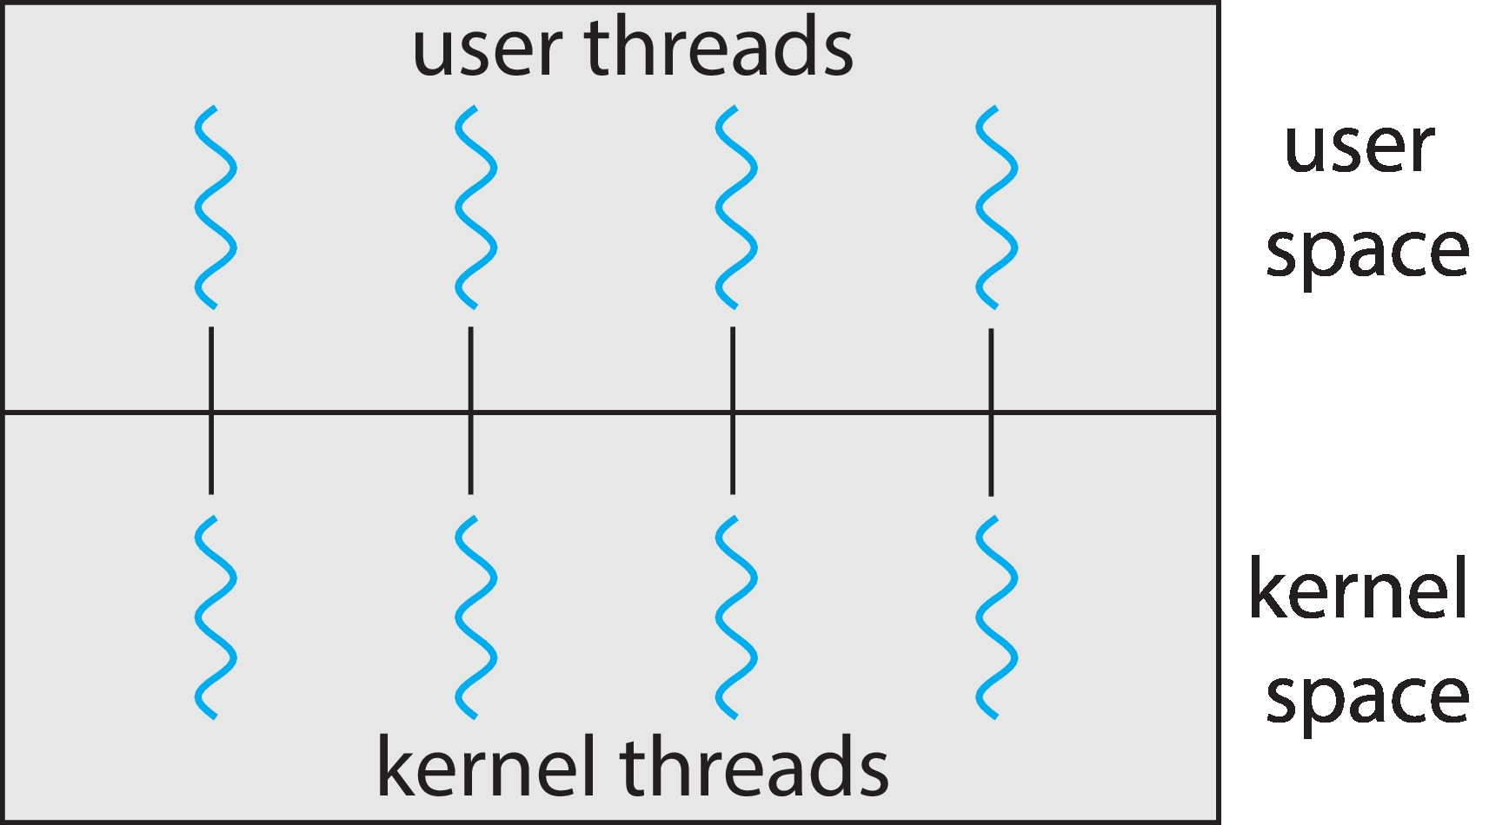
One-to-One
Each user-level thread maps to kernel thread
Creating a user-level thread creates a kernel thread
More concurrency than many-to-one
Number of threads per process sometimes restricted due to overhead
Examples
Windows
Linux

Slide 21

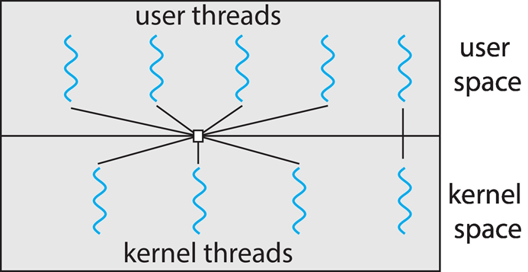
Many-to-Many Model
Many-to-Many l Model
Allows many user level threads to be mapped to many kernel threads
Allows the operating system to create a sufficient number of kernel threads
Windows with the ThreadFiber package
Otherwise not very common
Two-level Model

Slide 22
User Space vs Kernel-level Thread Library
User Space library
Code and data structures in user space, no system call
Kernel-level library
Code and data in kernel space, API function call → system call

